Slide 1

SYNOPSIS Presentation
on
GetPrep
by
Tarun Kumar 202410116100223
Tushar Kumar 202410116100227
Vaibhav Singh Kalura 202410116100233
Vishal Dagar 202410116100249
Session:2025-2026 (IV Semester)
Under the supervision of
Dr. Ankit Verma Associate Professor
Ms. Annu Yadav Assistant Professor
Department Of Computer Applications
KIET GROUP OF INSTITUTIONS, DELHI-NCR, GHAZIABAD-201206

Slide 2

Project Overview
GetPrep is an AI-driven platform that converts a user's profile and a uploaded Job Description (JD) into tailored, one-on-one mock interviews. It supports technical, behavioral, and coding rounds and delivers detailed, actionable feedback to close the gap between generic prep and role-specific readiness.
Key Functions
JD analysis, dynamic question generation, simulated interviews, automated scoring and feedback.
Impact
Improves candidate accuracy, provides measurable progress, and shortens interview preparation cycles.

Slide 3

Problem Statement
Current platforms offer non-specific practice and lack realistic simulation. There is no integrated AI-based evaluation tied to a target JD, resulting in poor role-alignment and limited measurable improvement for candidates.
Lack of personalized interview preparation
No realistic mock interview simulation
Generic content not tailored to JD
No AI-driven performance evaluation

Slide 4

Project Objectives
AI-driven Analysis
Parse JDs to extract skills, responsibilities, and competency expectations.
Dynamic Question Generation
Create technical, behavioral, and role-specific questions on demand.
Coding Round Automation
Auto-evaluate code submissions with test cases and complexity checks.
Performance Feedback
Provide scores, strengths, weakness summaries, and improvement suggestions.

Slide 5
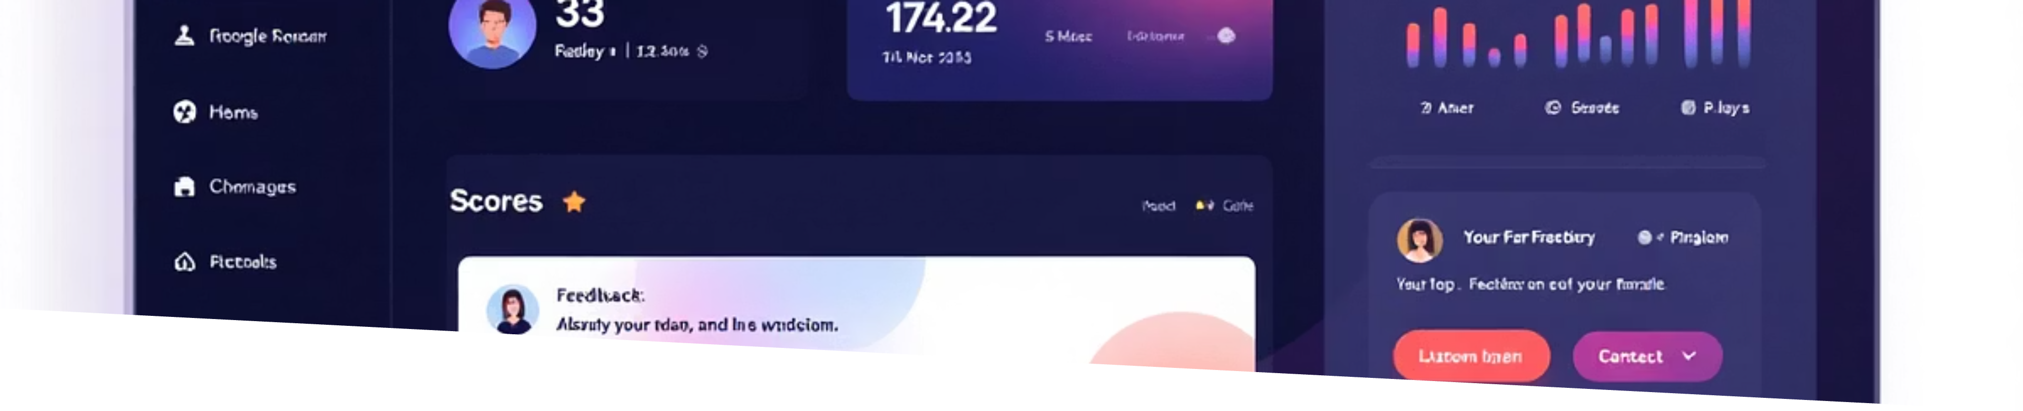
Project Scope — Inclusions & Exclusions
Included (Current Version)
Excluded (Current Version)
User authentication and profile management
JD upload and AI analysis
AI interview module (technical & HR)
Coding round with automated evaluation
Feedback system and dashboard
Live human interviewer
Real-time video interview support
Direct company API integrations

Slide 6
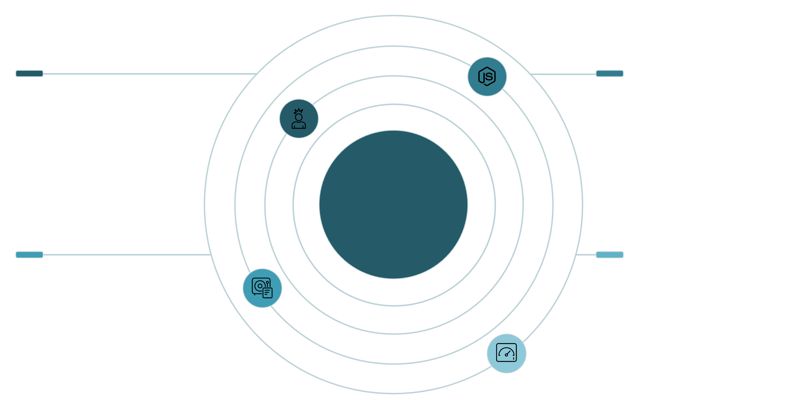
System Architecture
Frontend
Backend
React.js user interface sending requests
Node.js + Express handling auth and services
Layered System Architecture
AI & DB
Dashboard
OpenAI API + MongoDB/MySQL for JD parsing and eval
Analytics, interview results and monitoring
Frontend: React.js • Backend: Node.js/Express • Database: MongoDB / MySQL • AI: OpenAI API. The diagram highlights modular services: Auth, JD Parser, Interview Engine, Code Evaluator, and Analytics.

Slide 7

Methodology & Tools
Development follows Agile iterations with continuous integration and incremental delivery. Phases: Requirement Analysis → Design → Development → Testing → Deployment.
Frontend
HTML, CSS, JavaScript
Backend
Python- Flask, and FastAPI
Data & AI
MongoDB / MySQL
Dev Tools
GitHub, VS Code

Slide 8

Hardware & Software Requirements
Hardware
Software
Intel i3 or higher
4GB RAM minimum (8GB recommended)
10GB free storage
Stable internet connection
Windows / Linux / macOS
Node.js (LTS), MongoDB
VS Code, modern web browser
Access to OpenAI API key
Recommended: Use 8GB+ RAM during AI integration and code evaluation tests for reliable performance.

Slide 9
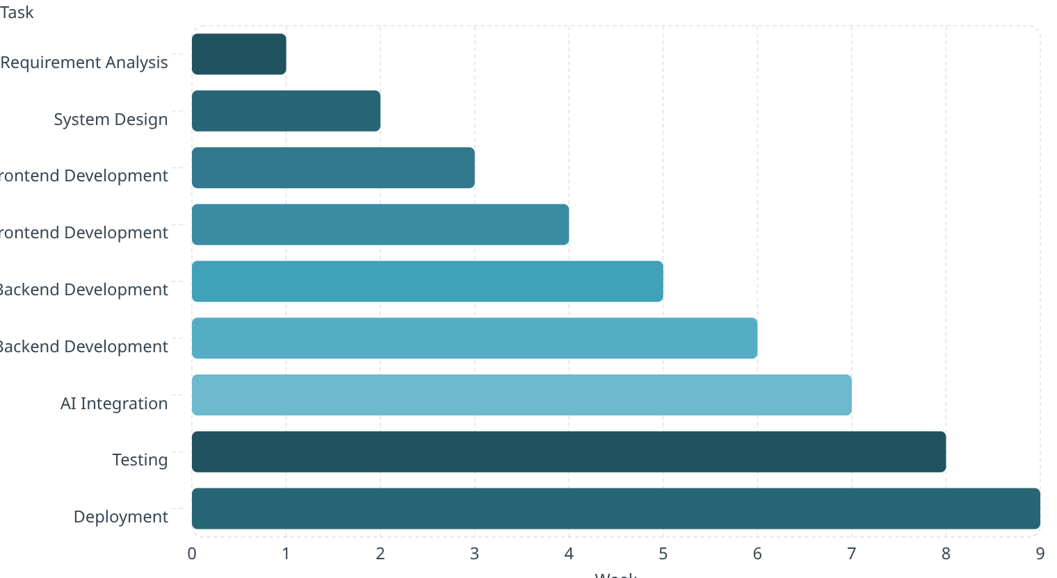
Project Timeline (Gantt View)
Gantt-style horizontal bars map tasks to weeks — parallel front/back development across Weeks 3–6, AI integration in Week 7, testing in Week 8, and deployment in Week 9.

Slide 10
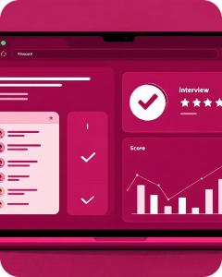


Outcomes & Future Enhancements
Project Outcomes
Potential Deliverables
Future Enhancements
Completed web app with AI JD analysis, automated mock interviews, coding evaluator, and a feedback dashboard. Ready for pilot testing and academic evaluation.
Opportunities for a research publication, provisional patent filing, and commercial deployment as a startup product.
Voice-based interviews, video AI assessment, facial expression analysis, company-specific prep, and resume parsing integration.
Next steps: run controlled user studies to quantify candidate improvement, refine question-generation models, and secure partnerships for pilot deployment.

